Slide 1
DELNET: Networking Libraries, Spreading Knowledge
by
Dr. Sangeeta Kaul
Network Manager, DELNET
New Delhi, India
Email : sangs@delnet.ren.nic.in,
sangskaul2003@yahoo.co.in
Web : www.delnet.in

Slide 2
INTRODUCTION
DELNET was established in 1988 as city based library network in Delhi, and was popularly known as Delhi Library Network, networking the libraries of the Delhi.
Got registered as a society in 1992.
On 13th September 2000, Delhi Library Network – DELNET became DELNET-Developing Library Network.
DELNET with passage of time and technological advancements not only widened its scope but has crossed the geographical boundaries. Presently, it is the major resource sharing library network in India connecting more than 6,742 libraries in 33 States and Union Territories in India and seven other countries.
The main objectives of DELNET is to promote resource sharing among the member-libraries by collecting, storing and disseminating information and by providing networked services to the researchers and scholars to supplement their research activity.

Slide 3
II - Network Resources
Since inception, DELNET is actively engaged in developing the union catalogues and union lists which are the major resource strength for any library network. It is worth mentioning that during the year 1992-1993, DELNET had saved 10 million of foreign exchange by rationalizing the periodicals available in the Delhi Libraries. DELNET databases are growing in size and with each passing day more and more resources are becoming accessible to the member libraries. These resources are the major source for resource sharing as they carry the locations data wherein physically the information may be available. The data collection methodology includes the electronic transfer of the exported records through email, ftp protocols, the data is physically sent in CDs by the member libraries, the data back-ups are also physically taken by the DELNET staff during their visits to the respective libraries. I would like to mention that in a country like India, the cooperative cataloguing or cooperative collection building is still not in existence.

Slide 4
Also, various libraries in the country are using various software packages which range from the commercial software packages (Libsys , Alice for Windows, Libman, Netlib, etc) to the in-house developed software packages developed with the backend on SQL, Access, Excel, Oracle, Sybase, etc. DELNET collects the records from the member libraries in the default exported format and the conversion programs are being developed to convert the base records into the standard ISO 2709 format before they are finally merged in the Union Catalogues. The databases like Union Lists are also being updated by DELNET as the data from the libraries is not available electronically and the whole task of data inputting is also done by DELNET. In case of Union Lists, the databases also comprises data of non-member institutions since they can always be approached for getting the desired information which may be available with them .

Slide 5
The DELNET databases are accessible through the World Wide Web by the registered member libraries of DELNET and their researchers and scholars. The DELNET online servers are being connected with 11 mbps RF link.
Some of the databases developed and updated by DELNET are mentioned below : -
II (a) Union Catalogue of Books :-
DELNET provides access nearly 3 crore bibliographic records of books in English script available with various member libraries located in and outside the country. The databases can be accessed by any of the desired fields including Title, Author, Subject, Date of Publication.

Slide 6
The Boolean operators can also be used for refining the search queries. The sorting can be done on the searched results. The searching using ‘Phrase Searching’, ‘Any Words’ and ‘Includes’ can be used. The records can also be retrieved using the specific indexes including Title, Author, Subject, etc. The database size grows with each passing day as more and more data from the member libraries are being merged in the centralized union catalogues. DELNET has developed its own modules on Basis plus software. The member libraries availing of the Interlibrary Loan facility can place requests online through the system itself. The Interlibrary Loan is one of the most popular services of DELNET, the resource sharing is done not only between the libraries located in India but also outside India. It is quite heartening to note that DELNET has evolved a very successful functional model of Interlibrary Loan/Document Delivery services. Through these services, the researchers and scholars of the member libraries are able to get and refer to the books which are not readily available in their own libraries, at times, the books are out of print and are not even available in the market.

Slide 7
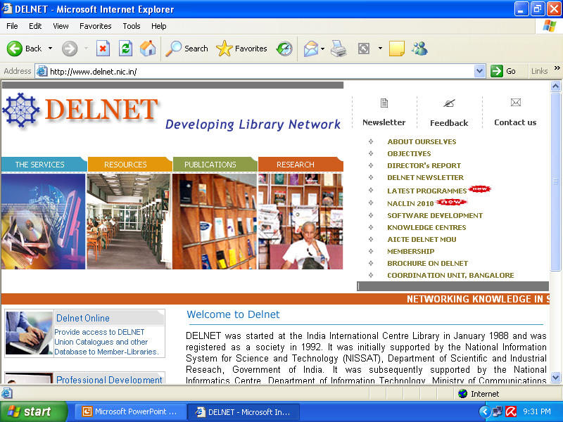

Slide 8
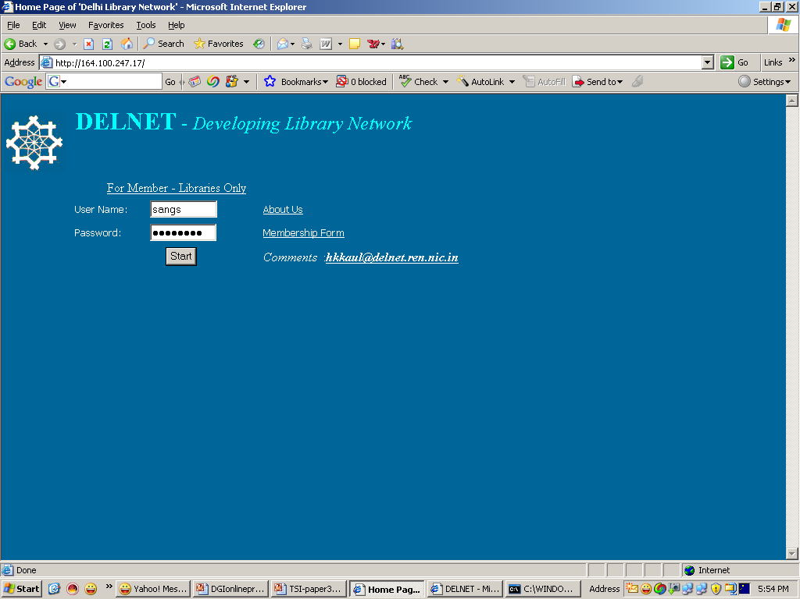

Slide 9
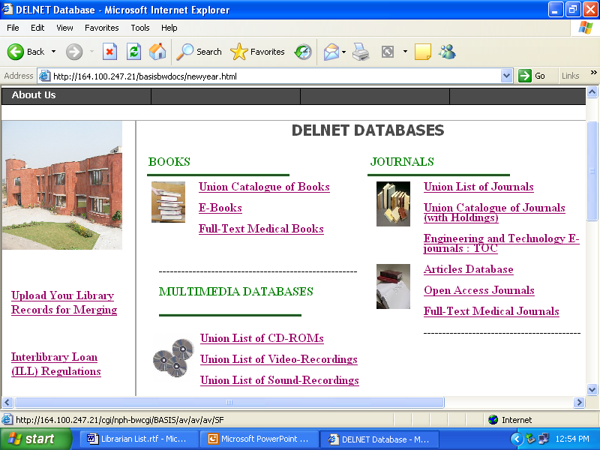

Slide 10
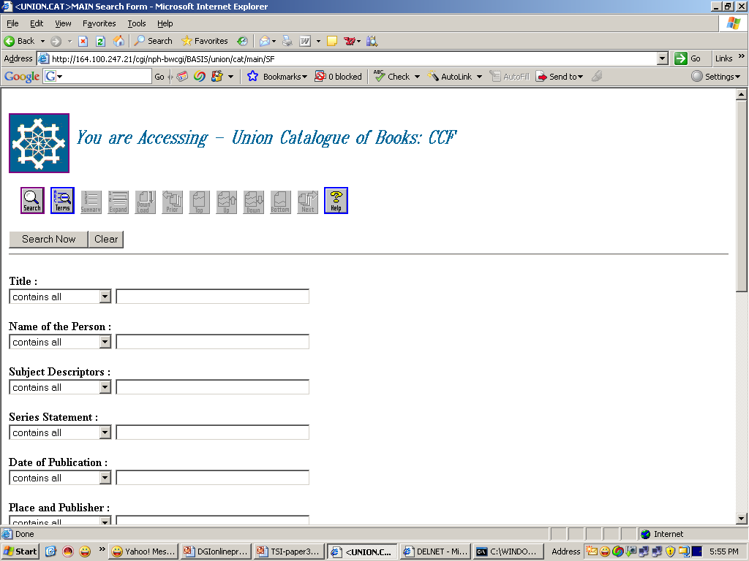

Slide 11
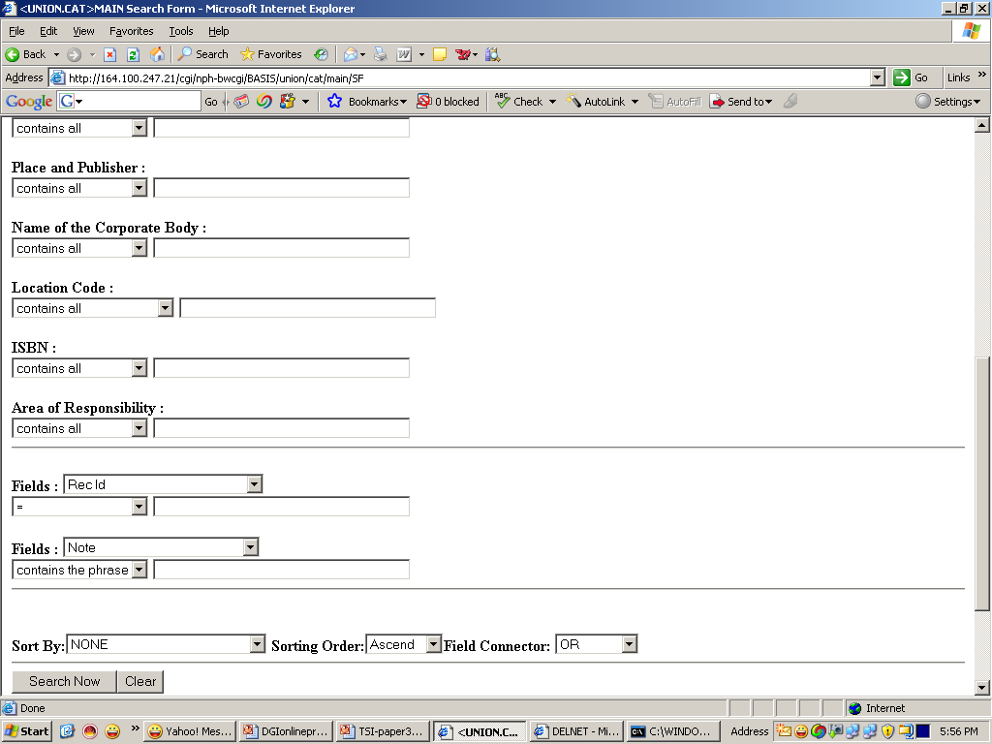

Slide 12
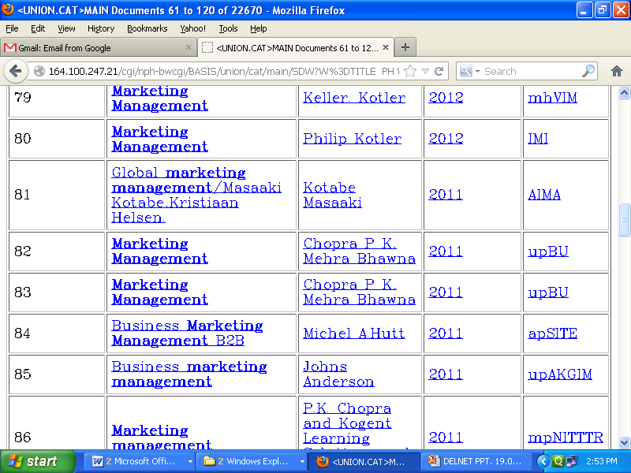

Slide 13
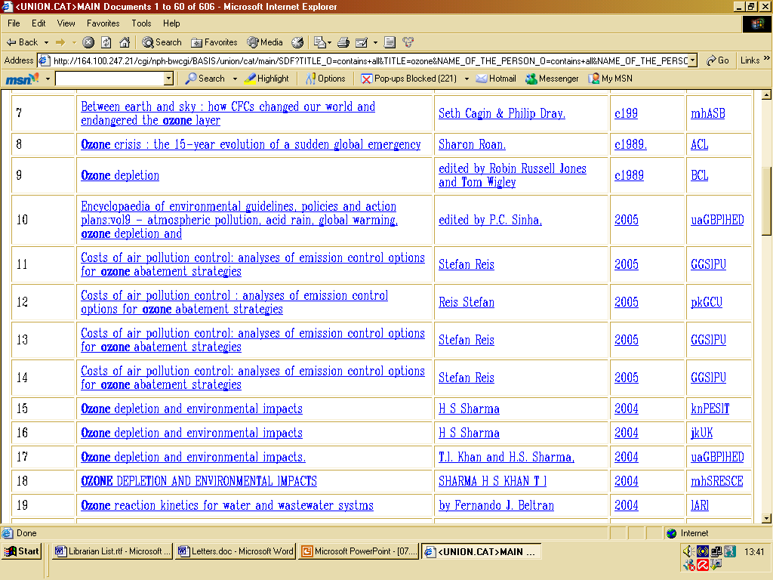

Slide 14
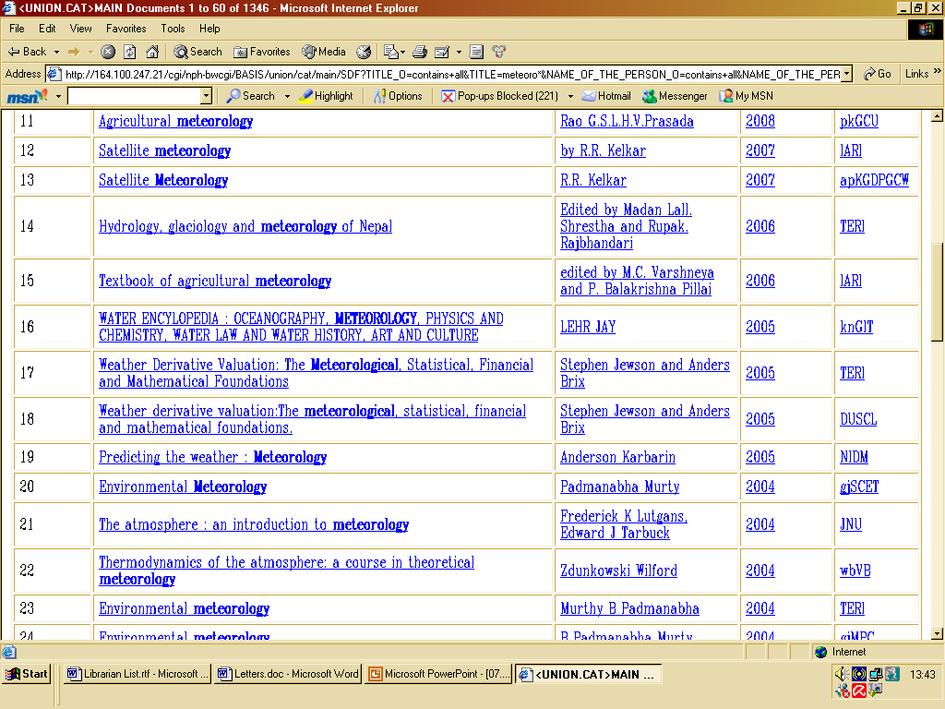

Slide 15
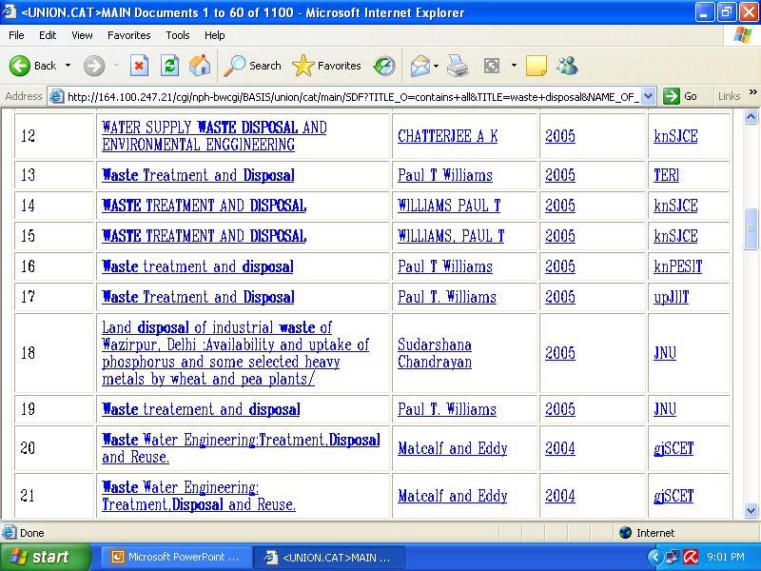

Slide 16
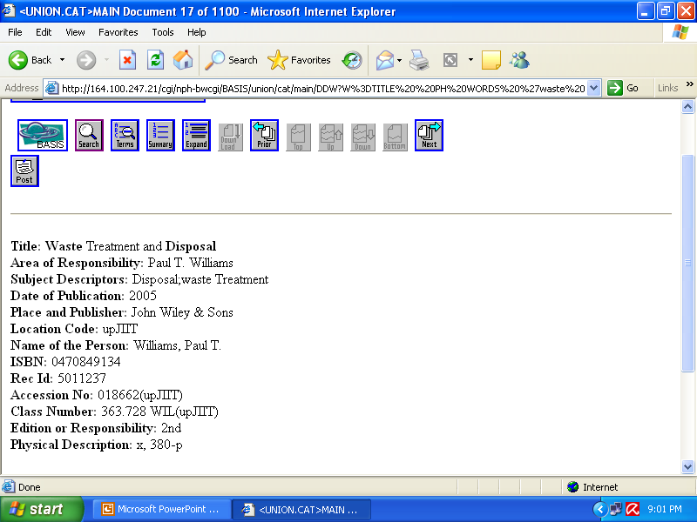

Slide 17
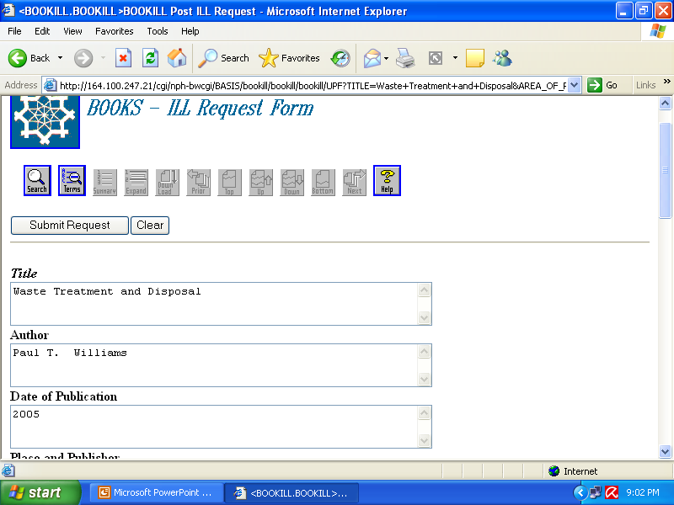

Slide 18
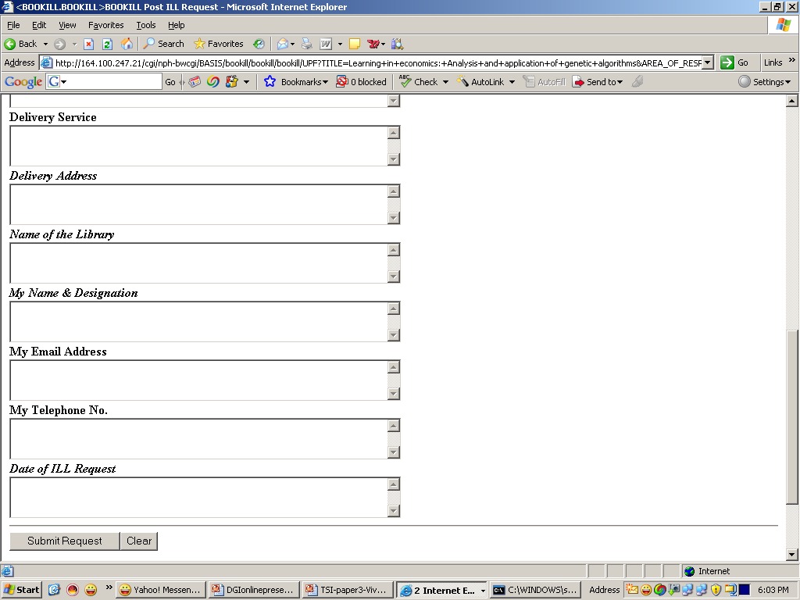

Slide 19
II (b) Union List of Current Journals :-
The information about the availability of the current journals is of great help for the document delivery services. DELNET is maintaining an online union list of current journals available in the fields of Science and Technology, Social Sciences and Humanities. This database has more than 38,184 unique titles of current journals available in member as well as non member libraries of DELNET. The database is updated continuously by receiving the list of currently subscribed journals and this database contains the information about the journals not only available with the member libraries but also with the major reputed libraries in India which are non members. The photocopies of journal articles are arranged from the libraries and supplied to the requesting libraries.

Slide 20
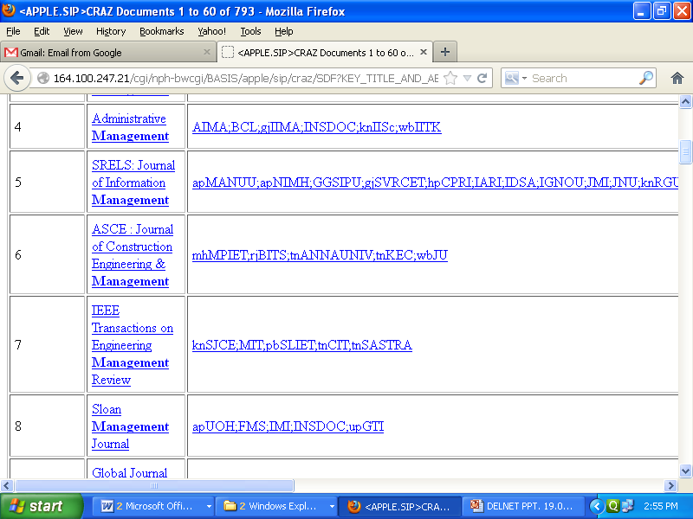

Slide 21
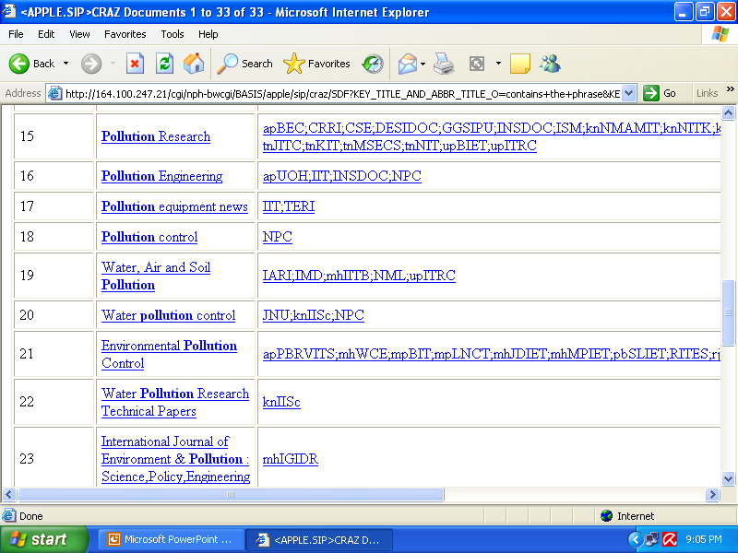

Slide 22
II ( c) Union Catalogue of Journals :-
DELNET has also created a database containing the bibliographic information and holdings data of the journals available in member libraries. At present the database contains 20,235 records of the journals. It is a good resource for tracking down the articles from rare and old issues of the journals dating back to late 19th and early 20th century. DELNET does receive a number of requests from the libraries from outside India for locating the journal articles from such old issues of the journals.

Slide 23
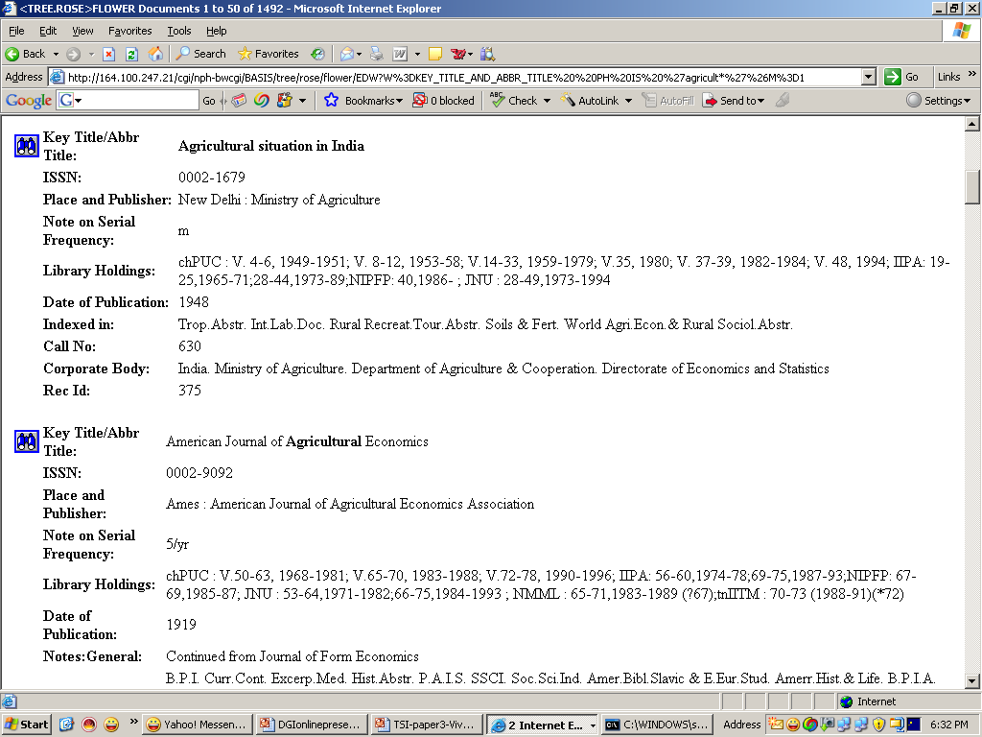

Slide 24
II (d) Database of Journal Articles :-
There are a number of libraries, though not many on the network which are involved with the articles indexing in the machine readable form. A large portion of the library budget is annually spent on subscribing to the journals, either in print or in online mode by the libraries but the libraries lack the access to the databases containing the bibliographic details about the journal articles. For the researchers and scholars it is very essential to know about the latest articles getting published in their specific fields of discipline. This specific database contains more than 9,84,809 records and is growing in size.

Slide 25
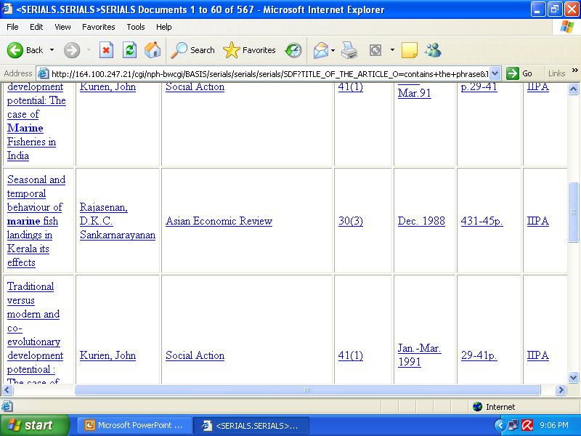

Slide 26
II (e) Databases of Non-print materials :-
DELNET does maintain the databases of CD-ROM, Video recordings and sound recordings available in the member libraries. The non-print materials can not be loaned out of the libraries, however the video recordings and sound recordings are being taken on loan in special cases though for lesser periods of time. The CD-ROMs are used for keyword searching and the concerned bibliography contains abstracts which are provided to the requesting libraries. There are 22,235 records of CDs available with member libraries, 1,025 sound recordings and more than 6,000 video recording listings in the respective databases.

Slide 27
II (f) Database of Thesis and Dissertations :-
This database contains around 1,29,400 Thesis and Dissertations submitted to various Universities and Institutions. This database contains bibliographic information and since thesis and dissertations are the reference materials available in the libraries, the researchers and scholars use this database to know about the research work being carried out in their specific fields.

Slide 28
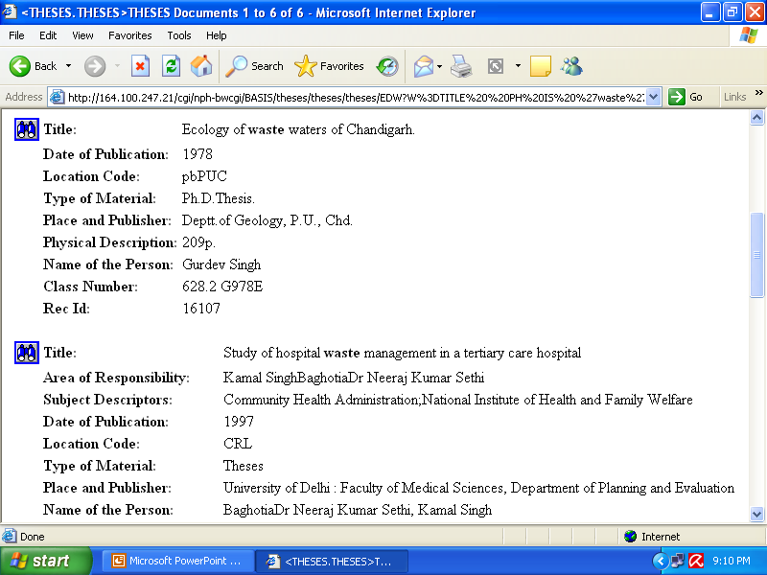

Slide 29
II (g) Directory of Member Libraries :-
The Directory of Member Libraries is also being created and is available for use by the member libraries. In order to promote the libraries, the links to their respective websites are also provided so that the interested users can know more about these organizations.

Slide 30
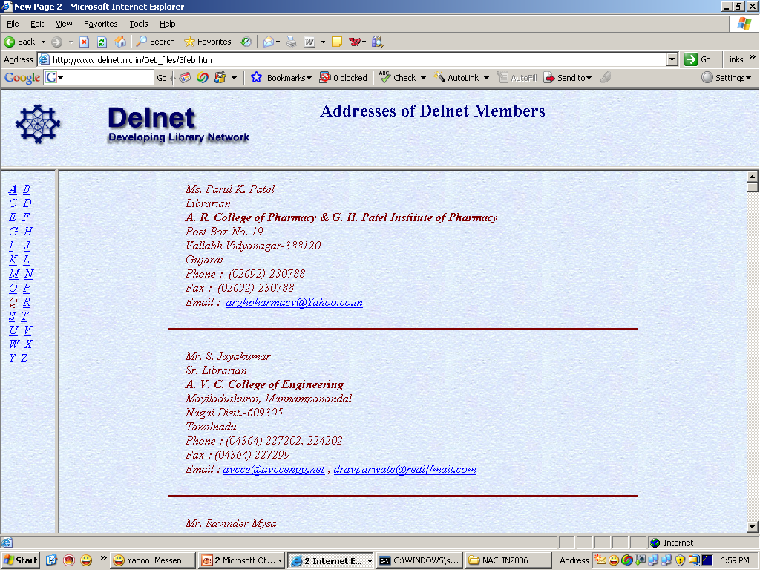

Slide 31
III DELNET’s Network Operations
The DELNET services are accessible through the World Wide Web by the registered member libraries. The DELNET databases are hosted on Basis Web server and are connected with a 11 mbps RF link offered by National Informatics Centre, Ministry of Communications and Information Technology, Government of India. The network remains functional on 24/7 basis. The web tracking software installed at DELNET servers gives a day to day picture of the usage of the DELNET services by the member libraries. It is quite heartening to note that the access to the server hosting databases are being made by the researchers and scholars of the member libraries at different times starting from midnight to early morning besides the usual peak hour network access.

Slide 32
IV THE SERVICES
IV (a) Inter-Library Loan (ILL) and Document Delivery Services (DDS) :-
The DELNET’s ILL and DDS services are one of the most popular services among the member libraries located in different parts of India as well as outside the country. The requests for the supply of books on Interlibrary Loan or the requests to arrange for the journal articles are received by DELNET through various modes including DELNET Online System (options are available through the online databases), Email (one of the most prevalent methods being used by member libraries), also through fax and at times through post.

Slide 33
DELNET promotes the electronic communication since it is more faster and interactive and it facilitate the process of quick and safe delivery of the ILL/DDS items. DELNET has a separate ILL tracking system wherein each and every transaction is recorded and status about its date of dispatch, date of return, etc. are well recorded. It is worth mentioning that DELNET not only provides the ILL/DDS to its member libraries located in various parts of the country but also it is engaged with International Inter-lending. DELNET sends books on Interlibrary Loan to the member institutions outside India like Baha Social Sciences, Katmandu, Nepal and Caledonian College of Engineering, Oman. Also the photocopies of journal articles are provided to member libraries in Sri Lanka, IRRI, Philippines, etc. DELNET is also working towards the implementation of ISO ILL protocols DELNET has also opened two coordination units in Southern and Western parts of India i.e. in Bangalore (Karnataka) and Pune (Maharashtra).

Slide 34
These units also coordinate for the ILL/DDS services. The nation wide catalogue of member libraries is available on the DELNET system and these coordination units deals on day-to-day basis with respective libraries of the region for the ILL/DDS services.

Slide 35
IV (b) Retro - Conversion :-
DELNET is a pioneer organization in India which undertook the creation of MARC 21 records in the country for the very first time. Under the National Bibliographic Database Pilot Project sponsored by Dept of Culture, Government of India, the retrospective conversion of 25,000 records was done at each of the libraries of the national importance which include the Asiatic Society, Mumbai; Asiatic Society, Kolkata; International Institute of Tamil Studies, Chennai; Punjabi University, Patiala; Andhra University, Visakhapatnam. DELNET has developed the software DELDOS which is MARC 21 compliant and it is used for this purpose. The work on all these projects is over now. DELNET undertakes retro-conversion projects selectively.

Slide 36
IV (c ) Reference Services :-
DELNET receives a large number of reference queries every day through various modes. DELNET maintains a referral centre which provides reference services to the participating libraries.

Slide 37
IV (d) Professional Training Programmes/Conventions :-
DELNET organizes professional training programmes for the LIS professionals from time to time. The training in MARC 21, development of Digital Libraries using Open Source Software, Effective Internet searching and the other topics of relevance are being covered. Recently PACE (Professional Advancement and Continuing Education) programmes have been introduced by DELNET wherein every month three workshop on the topics of Retro-conversion, Library Automation and Networking and Building Digital Libraries using Space are being organized. DELNET also organizes the Orientation Programmes in various parts of the country every month to promote the use of DELNET services by the member libraries. DELNET also organizes National Convention on Knowledge, Library and Information Networking (NACLIN) every year in different parts of India which are attended by a large number of professionals from India and also from outside India. The tutorials are also organized.

Slide 38
IV (e) Software Support to Member Libraries :-
In order to modernize and network different types of libraries in India, DELNET presents DELPLUS - the software for Library Management that conforms to international standards. It is multi-user software and ideal for all types of small and bigger libraries. It is offered to Member and Non-Libraries of DELNET at a subsidized price. Another software named “DEL-WINDOWS” is provided free of charge to the member libraries which allows them to create the bibliographic records in MARC 21 format and is provided with a retrieval module also.

Slide 39
DelPlus has the following modules :-
Acquisition
Cataloguing
Circulation
OPAC
Article Indexing
Serial Control
System Administration

Slide 40
DELNET Consortium
DELNET Consortium for E-journals and E-books for member-libraries against subscription.

Slide 41
V - National Initiatives
V (a) Networking of Technical Institutions of AICTE :-
In order to promote the networking and modernization of the technical institutes in the country, DELNET had signed an MOU with the All India Council for Technical Education, Government of India in 2001.

Slide 42
V (b) National Bibliographic Database :-
As mentioned earlier, DELNET was the first institution in India who started the preparation of MARC 21 records and have also developed the in-house software compatible with the format. With the financial assistance from Department of Culture, Government of India, 25,000 records each of the libraries of International Institute of Tamil Studies, Chennai; Punjabi University, Patiala; Andhra University, Visakhapatnam; Asiatic Society of Bombay, Mumbai and Asiatic Society, Kolkata were converted into MARC 21 records. The software for the purpose was also provided by DELNET to the respective libraries. The records in the Indian languages including Gurmukhi, Telegu, Tamil, Sanskrit were created using Gist Technology developed by CDAC Pune, while the records in Bengali script at Asiatic Society, Kolkata were created in the software called “Delvision” created by DELNET compliant to UNICODE standards.

Slide 43
V (c) Knowledge Centres :-
DELNET is promoting the opening of the Knowledge Centres in India with the support of Government of India and the State Governments. It is also supporting the modernization of public libraries in India. DELNET will soon be launching a national knowledge gateway. The plans are underway to develop the local content in various states in India and then make them accessible through the national knowledge gateway.

Slide 44
VI - DELNET Membership
VI (a) Membership Statistics :-
DELNET at present has 6742 libraries as its members which are located in 33 States and UTs in India and seven other countries. The detailed breakup of the members (regionwise, subjectwise, etc) are following :

Slide 45
MEMBERS IN INDIA
as on 27.08.2019
Geographical Distribution
Andaman and Nicobar | 2
Andhra Pradesh | 488
Arunachal Pradesh | 6
Assam | 29
Bihar | 38
Chandigarh | 19
Chhattisgarh | 82
Dadra & Nagar Haveli | 1
Daman and Diu | 2
Delhi | 287
Goa | 19
Gujarat | 272
Haryana | 341
Himachal Pradesh | 63
Jammu & Kashmir | 29
Jharkhand | 27
Karnataka | 279
Kerala | 226
Madhya Pradesh | 461
Maharashtra | 799
Manipur | 4
Meghalaya | 6
Mizoram | 2
Nagaland | 3
Odisha | 116
Puducherry | 27
Punjab | 240
Rajasthan | 327
Sikkim | 7
Tamil Nadu | 900
Telangana | 588
Tripura | 6
Uttar Pradesh | 830
Uttarakhand | 83
West Bengal | 111
TOTAL – 6720

Slide 46
MEMBERS OUTSIDE INDIA
as on 27.08.2019
Other SAARC Countries
Nepal 3 Sri Lanka 8 Bhutan 1
Outside SAARC
Oman | 4
Philippines | 1
United Arab Emirates | 3
United States | 2
TOTAL - 22

Slide 47
Subject-Wise Member Libraries as on 27.08.2019
Science and Technology | 6112
Social Science | 177
Humanities | 30
General | 423
TOTAL - 6742

Slide 48
Type-Wise Member Libraries as on 27.08.2019
Academic | 6265
Research/Special | 343
Public Libraries | 15
Government Libraries | 44
Libraries of Diplomatic Missions/UN Agency | 8
Miscellaneous/Trusts | 67
TOTAL - 6742

Slide 49
GROWTH OF DELNET MEMBERSHIP
GROWTH OF DELNET MEMBERSHIP

Slide 50
VI (b) Who can Join DELNET as a member :-
Any Institution/library situated in any part of the World and having any number of books in their library can join as an Institutional Member of DELNET. The Application form and the MOU to be submitted for the purpose are available at DELNET website at www.delnet.nic.in

Slide 51
VII (c ) Membership Charges :-
India and Other SAARC Countries
Admission Fee (one-time) Rs 5000 + 18% (GST)
Institutional Membership Fee Rs 11500 + 18% (GST)
per annum
Non-SAARC Countries
Admission Fee (One Time) US $ 100 +18% (GST)
Institutional Membership Fee US $ 500 + 18% (GST)

Slide 52
VIII - Agenda for the Future
DELNET is wanting to undertake the following tasks/projects in the days to come :
DELNET intends to network both libraries and knowledge in the integrated network model. While on one hand the National Knowledge Commission of the Government of India has identified DELNET as one of the major library network which will network more than 25,000 libraries in the near future in India, on the other, DELNET is supporting the establishment of Knowledge Centres and tries to create Knowledge which will be of interest to the common man. We hope that through these two networking channels, DELNET will be able to contribute a great deal not only to the modernization and networking of Libraries but also to the emerging knowledge society.

Slide 53
2) DELNET is keen to open shortly the State Centres in different parts of India and also the Regional Centres in order to provide training to the library professionals, promote the usage of network resources and also to help the local libraries in the development of the digital content.
3) DELNET is wanting that more libraries especially specializing in South Asian studies from different parts of the World should become a part of the network and utilize the services and resources created for their researchers and scholars at much affordable cost.

Slide 54
Awards for the Best Lending Libraries
DELNET has started awarding the best lending libraries for books and for journal articles. This is to promote the participation of the libraries and to encourage them in sharing their library resources.

Slide 55
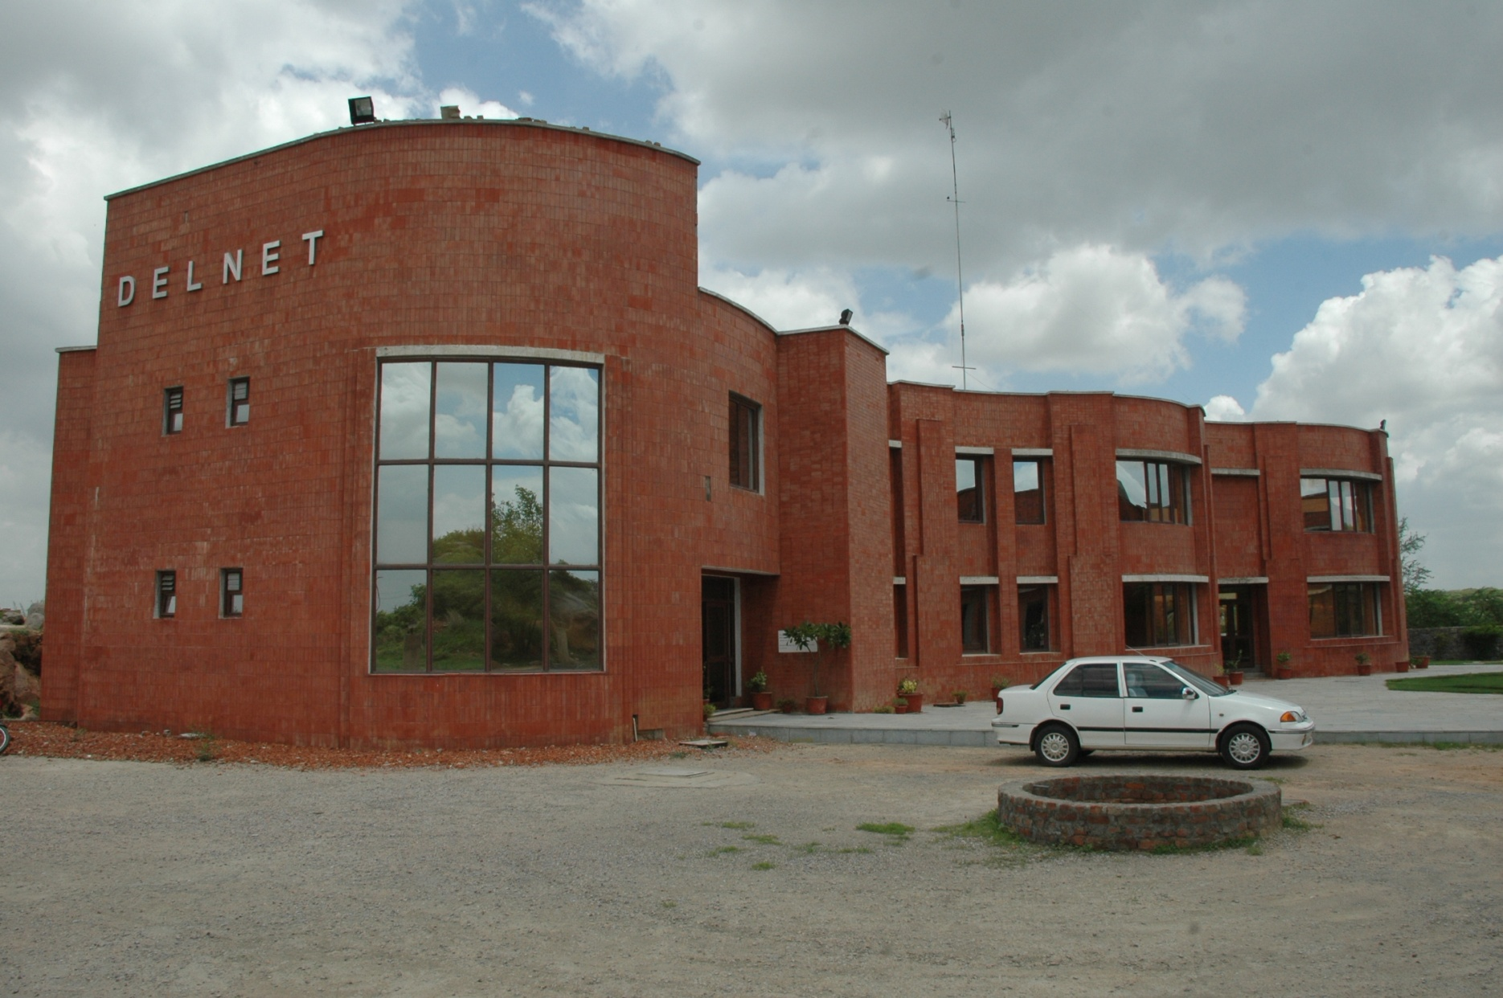
DELNET’s Building

Slide 56
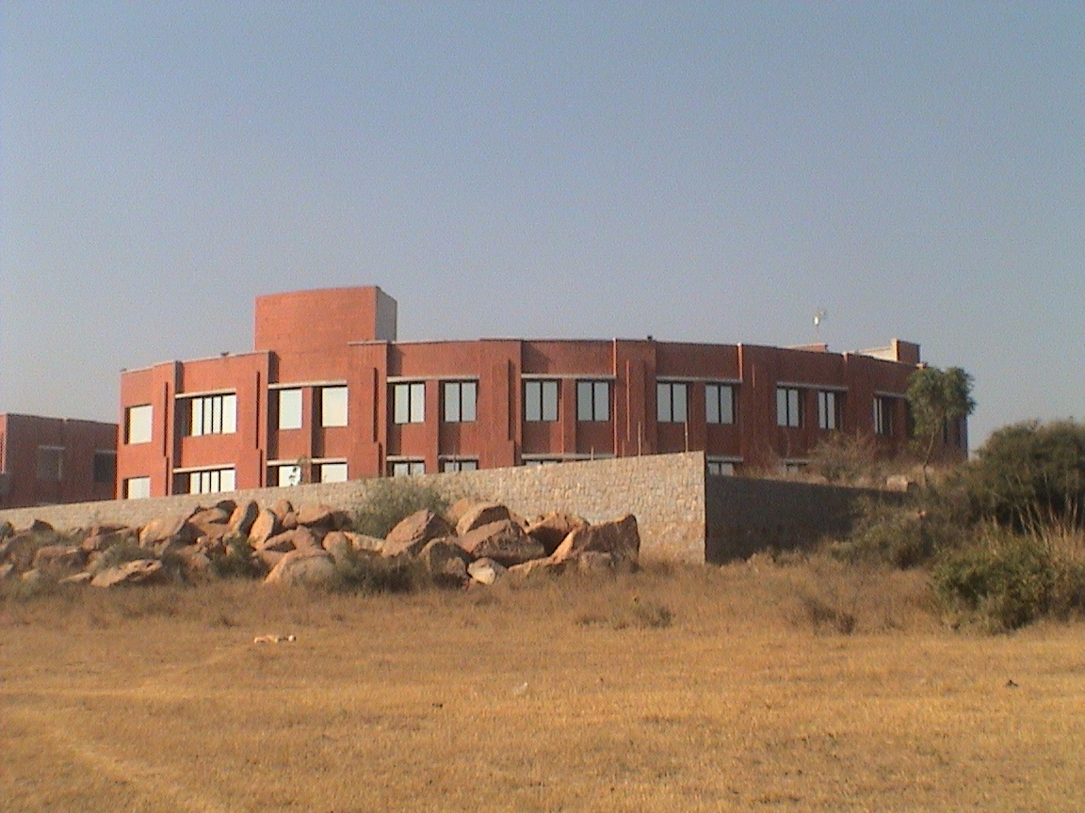

Slide 57
Thank You !

